Slide 1
The National Economy
The Scope of Macroeconomics

Slide 2
Fathers of modern macroeconomists
The foundation of macroeconomics was laid down by a British economist, John Maynard Keynes (1883 – 1946) in his revolutionary book “The General Theory of Employment, Interest and Money (1936)”.
Milton Friedman
James Tobin
Paul Samuelson
Robert E. Lucas Jr
Robert Solow
N. Gregory Mankiw etc.

Slide 3
Macroeconomics
Macroeconomics is the economics of the economy as a whole and microeconomics is the economics of the single market.
Macroeconomics simplifies by ignoring differences among individual households.
Macroeconomics is important — and even interesting — because it affects all of us.

Slide 4
Important issues in macroeconomics
Why does the cost of living keep rising?
Why are millions of people unemployed, even when the economy is booming?
Why are there recessions?
Can the government do anything to combat recessions? Should it?

Slide 5
Important issues in macroeconomics
What is the government budget deficit? How does it affect the economy?
Why does Ghana have such a huge trade deficit?
Why are so many countries poor?
What policies might help them grow out of poverty?

Slide 6
THE SCOPE OF MACROECONOMICS
Definitions
  Rate of economic growth: The percentage increase in national output over a 12-month period.
  Inflation: A persistent increase in the general price level over a given period of time. Rate of inflation is the percentage increase in prices over a 12-month period.
  Unemployment: those of working age who are without work, but who are available for work at current wage rates.

Slide 7
THE SCOPE OF MACROECONOMICS
Definitions
  Exchange rate: The rate at which one national currency exchanges for another. The rate is expressed as the amount of one currency that is necessary to purchase one unit of another currency (e.g. a Gh¢5.8 = $1)
  Balance of payments account: A record of the country’s transactions with the rest of the world. It shows the country’s payments to or deposits in other countries (debits) and its receipts or deposits from other countries (credits)

Slide 8
THE SCOPE OF MACROECONOMICS
The major macroeconomic issues/Goals of Macroeconomics
  (Rapid) economic growth: If output – real Gross Domestic Product (GDP)– grows faster than population, the average person can enjoy an improved standard of living
  High Employment (Unemployment): The main source of households’ incomes is labour earnings. When unemployment is high, many people are without jobs and must cut back their purchases of goods and services

Slide 9
THE SCOPE OF MACROECONOMICS
The major macroeconomic issues/Goals of Macroeconomics
  Inflation (Stable Prices): This goal is important because inflation imposes costs on society. Therefore keeping inflation rate low helps to reduce these costs.
  Balance of payments and stable exchange rates: A stable exchange rate will help reduce inflation, promote international trade and help the country achieve a favourable trade balance.

Slide 10
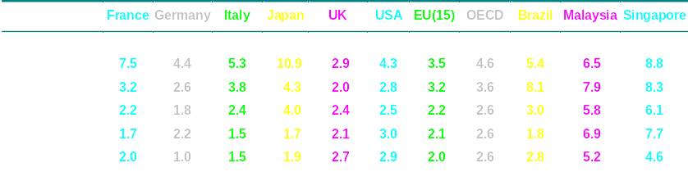
Economic growth (average % per annum),
Unemployment (average %), Inflation (average % per annum)

Slide 11
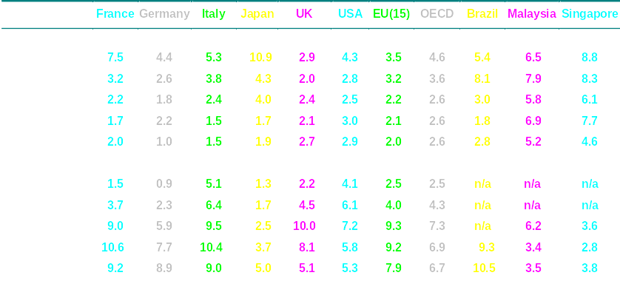
Economic growth (average % per annum),
Unemployment (average %), Inflation (average % per annum)

Slide 12
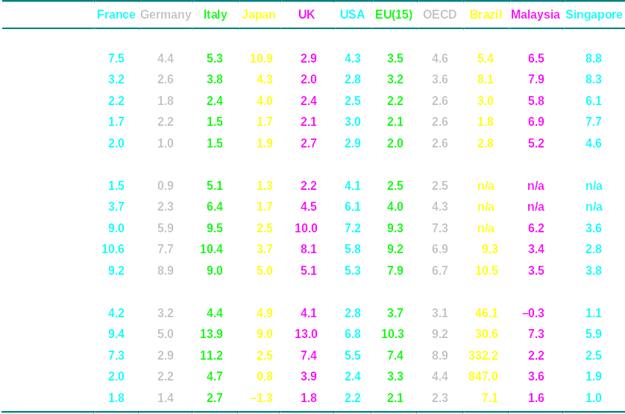
Economic growth (average % per annum),
Unemployment (average %), Inflation (average % per annum)

Slide 13
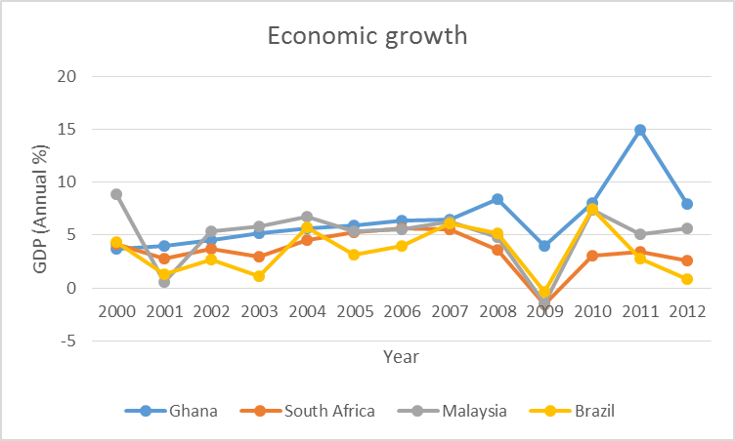

Slide 14
THE SCOPE OF MACROECONOMICS
Microeconomics and macroeconomics
The major macroeconomic issues
  economic growth
  unemployment
  inflation
  balance of payments and exchange rates
Government macroeconomic policy

Slide 15
THE SCOPE OF MACROECONOMICS
Microeconomics and macroeconomics
The major macroeconomic issues
  economic growth
  unemployment
  inflation
  balance of payments and exchange rates
Government macroeconomic policy
  choosing between macroeconomic theories

Slide 16
THE SCOPE OF MACROECONOMICS
Microeconomics and macroeconomics
The major macroeconomic issues
  economic growth
  unemployment
  inflation
  balance of payments and exchange rates
Government macroeconomic policy
  choosing between macroeconomic theories
  choosing the order of priorities

Slide 17
Societies face trade-offs between economic objectives.
  The goal of faster growth may conflict with that of greater equality;
  The goal of lower unemployment may conflict with that of lower inflation.
  The existence of trade-offs means that policy-makers must make choices

Slide 18
THE CIRCULAR FLOW OF INCOME
Aggregate demand (AD). This is the total spending on goods and services made within the country.
This spending consists of four elements.
AD = C + I + G + X − M
where,
C= Household Consumption
I =Investment
G=Government expenditure
X=Exports
M=Imports

Slide 19
The National Economy
The Circular Flow of Income

Slide 20
National Income Accounting and The Circular Flow of Income
National Income Accounting is the measurement of the annual output and income flows of an economy.
It provides basis for assessing the economic performance, for designing public policy and for understanding how all the sectors of an economy interact.

Slide 21
National Income Accounting and The Circular Flow of Income
It is an accounting framework used in measuring current economic activity in an economy over a period of time.
The various approaches for measuring national income and their links can be explained by the Circular Flow of Income Model.

Slide 22
The Circular Flow of Income

Slide 23
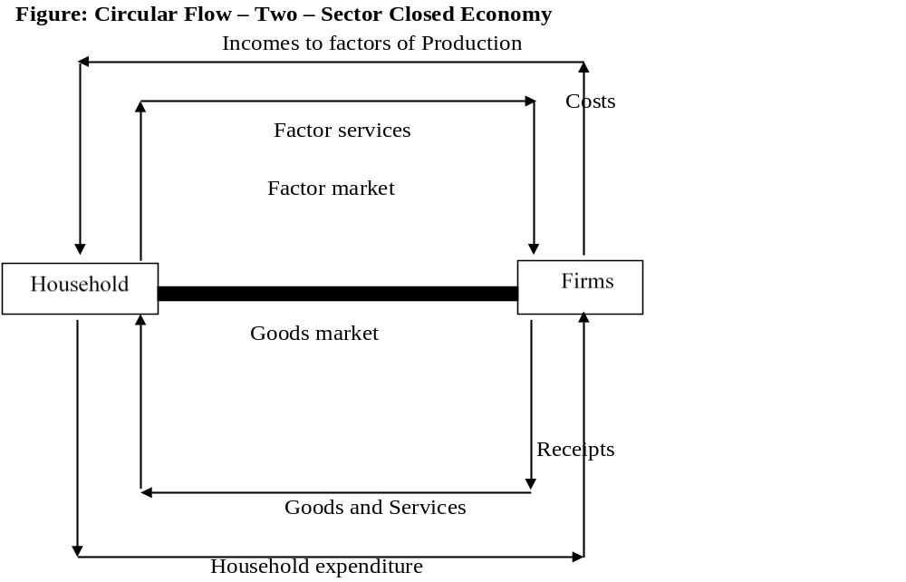
The Circular Flow of Income

Slide 24


The circular flow of income
Firms
Consumption of
domestically
produced goods
and services (C_{d})
Factor
payments
Households

Slide 25
THE CIRCULAR FLOW OF INCOME
Withdrawals (W):
Only part of the incomes received by households will be spent on the goods and services of domestic firms. The remainder will be withdrawn from the inner flow.
Likewise only part of the incomes generated by firms will be paid to the households. The remainder of this will also be withdrawn.
There are three forms of withdraws (or ‘leakages’).
  Net savings (S): Saving is income that households choose not to spend but to put aside for the future. Savings are normally deposited in financial institutions such as banks

Slide 26
THE CIRCULAR FLOW OF INCOME
Withdrawals (W):
  Net taxes (T): When people pay taxes (to either central or local government), this represents a withdrawal of money from the inner flow
  Import expenditure (M): Income spent on imported goods and services, or on goods and services using imported components.

Slide 27
THE CIRCULAR FLOW OF INCOME
Injections (J)
Only part of the demand for firms’ output arises from consumers’ expenditure.
The remainder comes from other sources outside the inner flow. These additional components of aggregate demand are known as injections
There are three types of injections.
  Investment (I): This is the money that firms spend after obtaining it from various financial institutions – either past savings or loans, or through a new issue of shares

Slide 28
THE CIRCULAR FLOW OF INCOME
Injections (J)
  Government expenditure (G): When the government spends money on goods and services produced by firms, this counts as an injection
  Export expenditure (E): Money flows into the circular flow from abroad when residents abroad buy our exports of goods and services

Slide 29

The circular flow of income
INJECTIONS
Export
expenditure (X)
Investment (I)
Government
expenditure (G)
Consumption of
domestically
produced goods
and services (C_{d})
Factor
payments
BANKS, etc
GOV.
ABROAD
Import
expenditure (M)
Net
taxes (T)
Net
saving (S)
WITHDRAWALS

Slide 30
THE CIRCULAR FLOW OF INCOME
The links between injections and withdrawals
There are indirect links between saving and investment, taxation and government expenditure, and imports and exports, via financial institutions, the government (central and local) and foreign countries respectively.
Example: If more money is saved (S), there will be more available for banks and other financial institutions to lend out (I).

Slide 31
THE CIRCULAR FLOW OF INCOME
The links between them (Example)
  If tax receipts are higher (T), the government may be more keen to increase its expenditure (G).
  If imports increase (M), incomes of people abroad will increase, which will enable them to purchase more of our exports (X).

Slide 32
The circular flow and the four macroeconomic objectives
However, Planned injections (J) may not equal planned withdrawals (W).
If injections exceed withdrawals, the level of expenditure will rise and AD will rise
Consequence on macroeconomic objectives
  Unemployment will fall
  Inflation will tend to rise
  The exports and imports part of the balance of payments will tend to deteriorate
  There will be economic growth

Slide 33
Equilibrium in the circular flow
When injections do not equal withdrawals, a state of disequilibrium will exist
This will set in train a process to bring the economy back to a state of equilibrium where injections are equal to withdrawals.
Assume injections exceeds withdrawals :
National income will increase
  People will save more (S), pay more taxes (T) and buy more imports (M). In other words, withdrawals will rise.
  This will continue until they have risen to equal injections

Slide 34
The National Economy
Measuring National Income

Slide 35
MEASURING NATIONAL INCOME
The three ways of measuring GDP
Gross domestic product (GDP): The value of output produced within the country over a 12-month period.
  the product method
  the income method
  the expenditure method

Slide 36


The circular flow of national income and expenditure

Slide 37
The circular flow of national income and expenditure
(1) Production
(2) Incomes
(3) Expenditure

Slide 38
MEASURING NATIONAL INCOME
The product (Output) method: This is the market value of final goods and services produced by countries’ own factors of production within a given period.
That is adding up the monetary value of the physical goods and services in an economy within a given period, usually within a year.
The final total output is called National Product of Output/GDP.

Slide 39
MEASURING NATIONAL INCOME
The output approach involves adding up the market value of the total output (goods and services) of all firms in the various sectors of the economy (agriculture, mining, manufacturing, services, etc) in a year.
This yields the GDP at market price

Slide 40
MEASURING NATIONAL INCOME
The product (Output) method:
Stages of production | Value of output (Cedis) | Cost of intermediate goods (Cedis) | Gross Value Added (GVA) (Cedis)
Farmer sells cassava | 8,000 | 0 | 8,000
Miller turning cassava to cassava dough | 11,000 | 8,000 | 3,000
Woman turning dough to gari | 20,000 | 11,000 | 9,000
Gari delivered to retailer | 30,000 | 20,000 | 10,000
Total | 69,000 | 39,000 | 30,000

Slide 41
MEASURING NATIONAL INCOME
The product (Output) method
Net Factor Income from abroad: The difference between income earned by foreigners in the domestic country and income earned by the citizens residing abroad)
GDP at market prices + Net Factor Income from abroad = Gross National Product (GNP) at market prices.
GNP at market prices – Indirect taxes + subsidies = GNP at factor cost.
GNP at factor cost – Depreciation = Net National Product (NNP) at factor cost.

Slide 42
MEASURING NATIONAL INCOME
Problems of the product (Output) method
  The problem of double or multiple counting
  Non-marketed activities
  Underground activities
  Poor Statistics
  The valuation of public services

Slide 43
MEASURING NATIONAL INCOME
The Income method/approach
  The National Income is arrived at by adding up all the money values of incomes earned (wages, rent, dividend, interest etc) by the factors of production employed in producing the output in an economy within a specified period of time like one year
  There are four factors of production. These are labour, land, capital and entrepreneurship.

Slide 44
MEASURING NATIONAL INCOME
The Income method/approach
  Wages and salaries are paid to labour;
  Rent and interest are paid to land and capital respectively and profit o entrepreneurship.
  If all remunerations to factors of production are added up, the value should be equal to the total expenditure on total output.

Slide 45
MEASURING NATIONAL INCOME
The Expenditure method/approach
This approach measures the total expenditure needed to purchase output produced in the economy within a year.
It is the expenditure of households, firms and government within a year.
Total or Aggregate expenditure (AE) therefore is the sum of consumption expenditure on final goods and services and net exports (Exports minus Imports).

Slide 46
MEASURING NATIONAL INCOME
The Expenditure method/approach
That is:
AE = C + I + G + (X − M)
where,
C= Household Consumption
I =Investment
G=Government expenditure
X=Exports
M=Imports

Slide 47
MEASURING NATIONAL INCOME
The Expenditure method/approach
Problems with the expenditure approach
The high illiteracy rate in developing countries including Ghana makes record keeping on expenditures very difficult to permit a reasonable assessment of expenditures.
A large proportion of the national expenditure consists of private expenditures from the small-scale earners who are unwilling to give correct information on their expenditures for fear of high taxes.
Subsistence production makes it difficult to compute subsistence consumption

Slide 48
Nominal versus real GDP
Nominal GDP, measures GDP in the prices ruling at the time and thus takes no account of inflation.
Real GDP measures GDP in the prices that ruled in the base year. Thus we could measure each year’s GDP in, say, 1990 prices.
This would enable us to see how much real GDP had changed from one year to another. In other words, it would eliminate increases in money GDP that were merely due to an increase in prices.

Slide 49
Taking account of population:
  the use of per-capita measures
Taking account of exchange rates:
  the use of PPP measures:
  For example, $1 may exchange for, say, Gh¢4.26. But will $1 in the US buy the same amount of goods as
  Gh¢4.26 in Ghana? The answer is almost certainly no

Slide 50
  To compensate for this, GDP can be converted into a common currency at a purchasing power parity (PPP) rate.
  PPP rate is the rate of exchange rate that would allow a given amount of money in one country to buy the same amount of goods in another country after exchanging it into a currency of the other country.

Slide 51
MEASURING NATIONAL INCOME
National income statistics: Suitable measures of living standards?
  Items that are excluded
    non-marketed items
    the underground economy
  Production: poor indicator of welfare?
    production does not equal consumption
    human costs of production
    Externalities (external costs)
    the production of 'regrettables'
    distribution of income
  The use of GDP per capita (GDP/Total population)

Slide 52
Short-term Growth and the Business Cycle

Slide 53
SHORT-TERM GROWTH & THE BUSINESS CYCLE
Actual and potential national income
  Actual growth is the percentage annual increase in national output: the rate of growth in actual output
  Potential economic growth: It is the percentage annual increase in the economy’s capacity to produce: the rate of growth in potential output.
  Contributors to potential economic growth are:
  Discovery of natural resources
  Technological advances leading to efficiency

Slide 54



Growth and the production possibility curve
Growth in
actual output
Good X
c
b
a
O
Good Y

Slide 55

Growth and the production possibility curve
Growth in
potential output
Good X
x
I
II
O
Good Y

Slide 56

Growth and the production possibility curve
Growth in
actual and
potential output
y
Good X
x
I
II
O
Good Y

Slide 57
SHORT-TERM GROWTH & THE BUSINESS CYCLE
Actual and potential national income
  actual and potential economic growth
Economic growth & the business cycle

Slide 58
SHORT-TERM GROWTH & THE BUSINESS CYCLE
Actual and potential national income
  actual and potential economic growth
Economic growth & the business cycle
Business cycle is the periodic fluctuation of national output around its long-term trend.
  fluctuations in actual growth
A business cycle may thus be defined as alternating periods of economic growth and contraction in an economy

Slide 59
SHORT-TERM GROWTH & THE BUSINESS CYCLE
Actual and potential national income
  actual and potential economic growth
Economic growth & the business cycle
When the actual GDP is above trend for a number of years in a row the economy is regarded as experiencing a boom or an expansion
When the actual GDP is below trend for a number of years in a row we say that the economy is in contraction or recession.

Slide 60
SHORT-TERM GROWTH & THE BUSINESS CYCLE
Actual and potential national income
  actual and potential economic growth
Economic growth & the business cycle
Phases of Business Cycle
  Upturn: contracting or stagnant economy begins to recover
  Expansion: there is rapid growth: the economy is booming
  Peak: growth slows down or even ceases
  Slow down or recession: there is little or no growth or even a decline in output

Slide 61

The business cycle
Potential output
3
National output
4
2
Actual
output
3
4
2
1
1
O
Time

Slide 62
SHORT-TERM GROWTH & THE BUSINESS CYCLE
Actual and potential national income
  actual and potential economic growth
Economic growth & the business cycle
  fluctuations in actual growth
    the phases of the business cycle
      upturn
      expansion
      peaking out
      slowdown or recession
  Long-term output trend
    sustainable national income

Slide 63
SHORT-TERM GROWTH & THE BUSINESS CYCLE
Actual and potential national income
  actual and potential economic growth
Economic growth & the business cycle
  fluctuations in actual growth
    the phases of the business cycle
      upturn
      expansion
      peaking out
      slowdown or recession
  Long-term output trend
    sustainable national income

Slide 64
SHORT-TERM GROWTH & THE BUSINESS CYCLE
Long-term Output Trend
A line can be drawn showing the trend of national output over time (i.e. ignoring the cyclical fluctuations around the trend)
If the average level of potential output that is unutilised stays constant from one cycle to another, the trend line will have the same slope as the potential output line.
In other words, the trend rate of growth will be the same as the potential rate of growth.

Slide 65
The business cycle
Potential output
Trend
output
National output
Actual
output
O
Time

Slide 66
SHORT-TERM GROWTH & THE BUSINESS CYCLE
Causes of fluctuations in growth
  Changes in aggregate demand
    A rapid rise in aggregate demand will create shortages. This will tend to stimulate firms to increase output. The reverse holds
  Changes in aggregate demand relative to potential output
    Expansion of potential output in relation to increased aggregate demand

Slide 67
The National Economy
Long-term Economic Growth

Slide 68
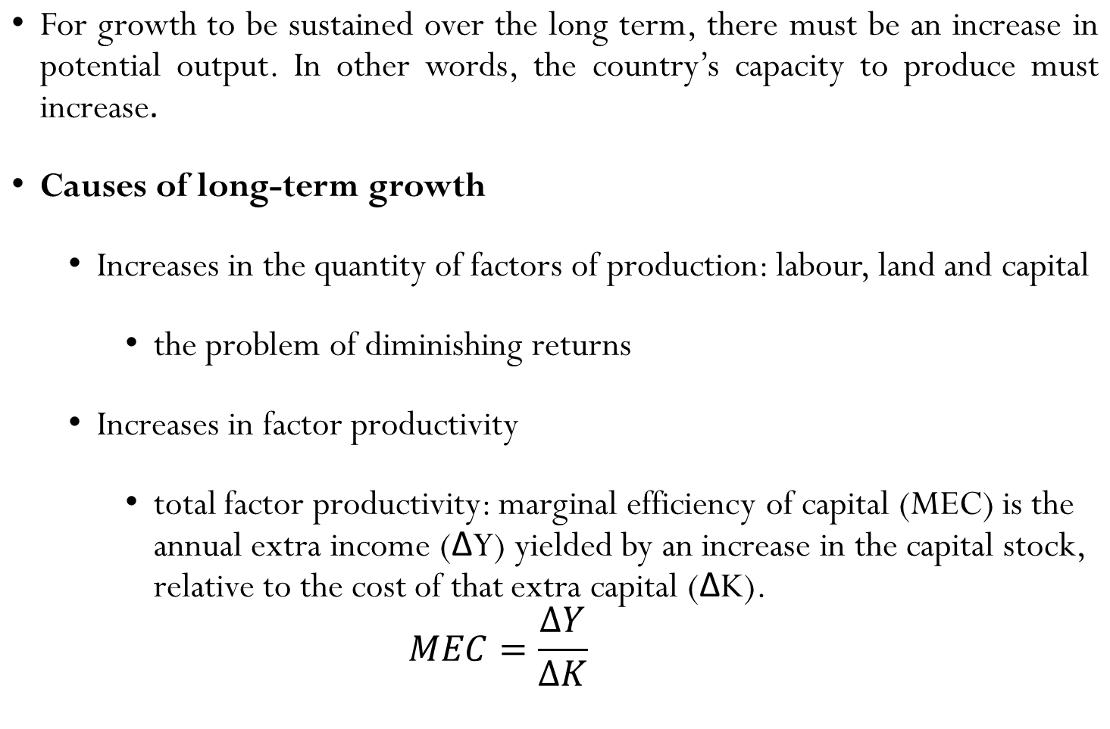
LONG-TERM ECONOMIC GROWTH

Slide 69
LONG-TERM ECONOMIC GROWTH
Example: if GH¢100 million of extra capital yielded an annual income of ¢25 million, the marginal efficiency of capital would be ¢25 million/¢100 million=(1/4).
  Effects of actual growth on potential growth
    Actual growth stimulates investment and the development of new technology
    the importance of investment: Investment plays a twin role in economic growth (Think about it!!).

Slide 70
LONG-TERM ECONOMIC GROWTH
Policies to achieve growth
  Demand-side policies
  Fiscal and monetary policies are intended to increase aggregate demand
  The principal policy instruments are government expenditure, taxation (fiscal policy); and the stock of money in circulation and interest rate (monetary policy)

Slide 71
LONG-TERM ECONOMIC GROWTH
Policies to achieve growth
  Supply-side policies
  These policies are intended to increase the economy’s potential rate of output by increasing the supply of factor inputs and by increasing productivity
    Example: providing subsidies to firms

Slide 72
LONG-TERM ECONOMIC GROWTH
The desirability of economic growth
  The benefits of economic growth
    increased consumption
    reduces other macro problems
    easier to redistribute incomes to the poor

Slide 73
LONG-TERM ECONOMIC GROWTH
The desirability of economic growth
  The costs of economic growth
    current opportunity costs
      Higher savings for investment would mean a cut in consumption
    may generate extra wants
    adverse social effects
      an excessive pursuit of material growth by a country can lead to a more greedy, more selfish and less caring society: suicides, divorce and other

Slide 74
LONG-TERM ECONOMIC GROWTH
The desirability of economic growth
  The costs of economic growth
    environmental costs
      pollution and waste
    depletion of resources

Slide 75
Thank You

